Slide 1

COVID-19 Data Visualizations
Project 2 – Group 5
Juveriya Baig, Mark Burton, Kris wasemiller, and Jim Worlein

Slide 2
Inspiration

Slide 3
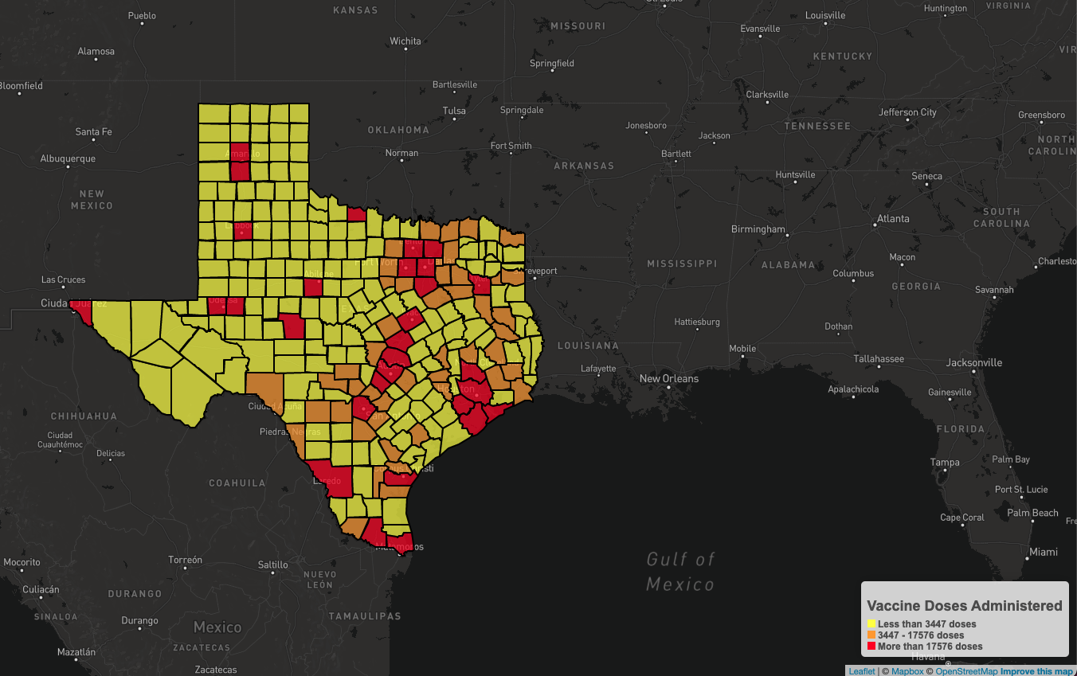
Placeholder

Slide 4
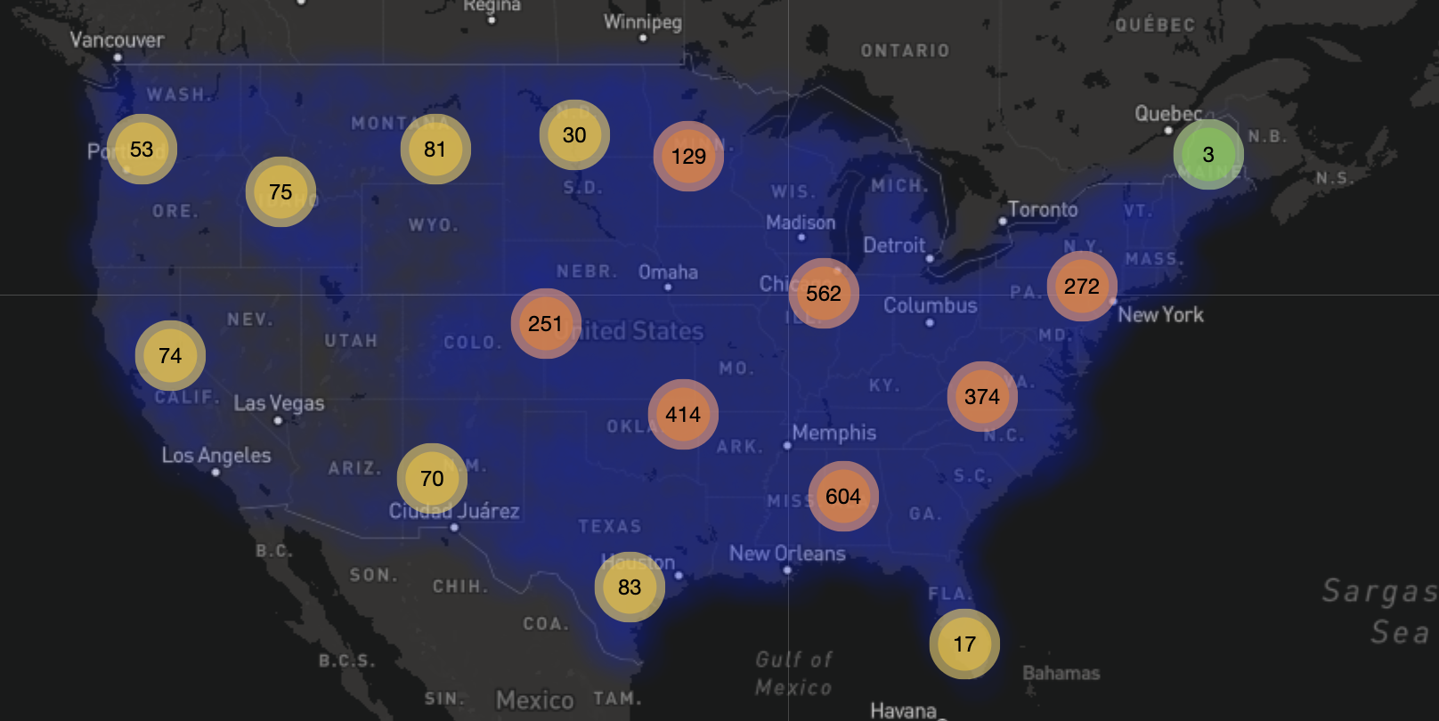
Placeholder

Slide 5
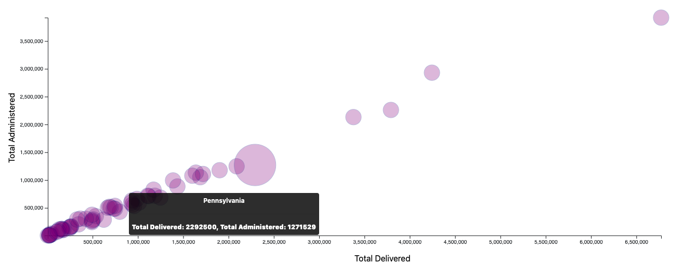
Placeholder

